Slide 1
Metabolism and Enzymes
Year 11 Human Biology
ATAR
PowerPoint #7

Slide 2
SCSA Syllabus Reference
Biochemical processes, including anabolic and catabolic reactions in the cell, are controlled in the presence of specific enzymes
For efficient metabolism, cells require oxygen and nutrients, including carbohydrates, proteins, lipids, vitamins and minerals
Enzyme function can be affected by factors including pH, temperature, presence of inhibitors, co-enzymes and co-factors, and the concentration of reactants and products

Slide 3
Lesson Intention
To describe the process of metabolism and the role of different organic molecules in it.
To identify inorganic compounds in biochemical processes
To explore the role of enzymes as biological catalysts and the factors that affect their activity

Slide 4
Success Criteria
define metabolism
distinguish between catabolism and anabolism
recognise different organic substances e.g. carbohydrates and proteins
describe the structure of different organic substances.
define the terminology involved with enzymes
use the lock-and-key model and induced fit model to explain how enzymes work.
state and explain how different factors affect enzyme activity

Slide 5
Vocabulary
Metabolism: all the chemical reactions occurring in a living organism
Catabolism: chemical reactions that break down large organic molecules into smaller ones, with the release of energy
Anabolism: the process of combining small molecules to make larger ones; it requires energy.
Nutrient: any substance in food that provides energy, is essential for growth, or assists in the functioning of the body.

Slide 6
Vocabulary
Organic compound: substances that have large molecules and contain carbon, such as carbohydrates, amino acids and proteins.
Carbohydrates: organic molecules that are the main source of energy for cells.
Protein: organic compounds that are made up of many amino acids.
Inorganic compounds: not containing carbon or having small molecules.

Slide 7
Vocabulary
Enzyme: an organic substance (usually a protein) that increases the speed of chemical changes without being altered or destroyed in the change; an organic catalyst.
Activation energy: the energy needed to break the bonds of the reacting particles in a chemical reaction; the energy needed to start a chemical reaction.
Catalysts: a substance that lowers the activation energy of a reaction, increasing the rate of reaction without being consumed.

Slide 8
Vocabulary
Substrate: a molecule upon which an enzyme reacts.
Active Site: the part of an enzyme molecule that combines with the substrate.
Enzyme-substrate complex: the structure formed when an enzyme and a substrate combine

Slide 9
Metabolism
Metabolism is made up of two different types of chemical reaction:
Catabolic metabolism is the reactions in which large molecules are broken down to smaller ones. Catabolic reactions release energy. E.g. digestion
Anabolic metabolism is the reactions in which small molecules are built up into larger ones. Anabolic reactions require energy. E.g. protein synthesis.

Slide 10
Nutrients
Nutrients are used for growth, repair or maintaining the body, that is, any substance required for metabolism.
There are six groups of nutrients:
Water
Carbohydrates
Lipids
Proteins
Minerals
Vitamins

Slide 11
Organic Compounds
Organic compounds are molecules with a carbon chain.
This includes carbohydrates, lipids, proteins and nucleic acids

Slide 12
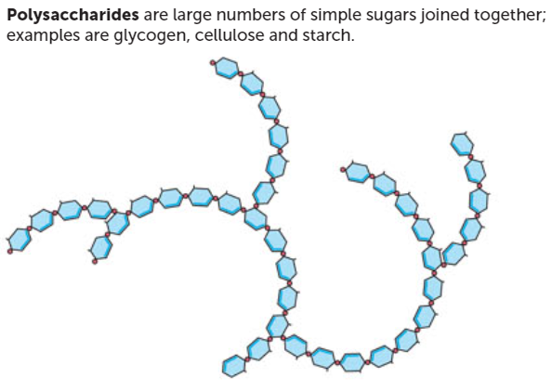
Carbohydrates
Main source of energy for cells
Simple sugars (glucose) are used in cellular respiration to release energy, while complex carbohydrates (starch) are broken down into simple sugars.

Slide 13
Lipids
Includes fats and oil and are another important energy source.
They are broken down into fatty acids and glycerol. The glycerol can then enter the glycolysis pathway to cellular respiration.
Other examples of lipids are phospholipids, which are important in the cell membrane, and steroids, including cholesterol and sex hormones.

Slide 14
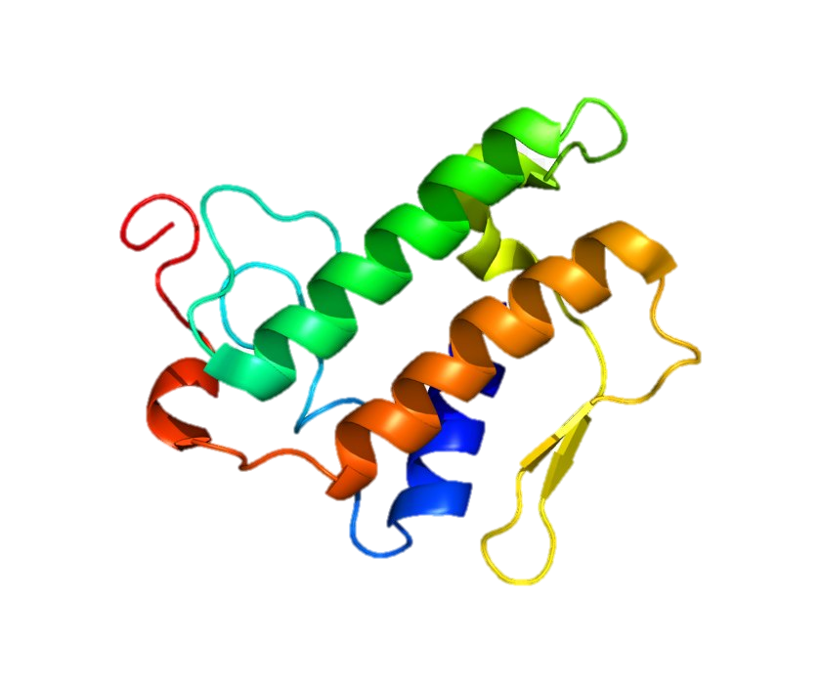
Proteins
Proteins are made up of many amino acids.
With regard to metabolism, the most important proteins made are enzymes. Enzymes influence metabolism by controlling the chemical reactions that occur in the body. Proteins can also be used as a source of energy, but only if the supply of carbohydrates and lipids is inadequate.

Slide 15
Inorganic Compounds
Not based on a carbon chain, most don’t contain carbon at all
Water is important because it dissolves substances and is involved in some chemical reactions
Minerals may be part of enzymes or substances involved in metabolism
Vitamins act as coenzymes for many of the chemical reactions of metabolism

Slide 16
Chemical reactions
There are certain conditions that must be met for a chemical reaction to occur. The reacting particles need to collide with enough energy to break the bonds. This is the activation energy
The particles must also collide with the correct atoms.
Chemicals called catalysts are able to decrease the amount of energy needed to break the bonds. This means that the activation energy will be lower and more particles with enough energy to react.

Slide 17
Catalysts
Catalysts are particularly effective because they are not consumed during the reaction, and therefore can influence many reacting particles.
Catalysts are proteins called enzymes. Enzymes allow chemical reactions to occur at a fast enough rate at body temperature fo the body to function.

Slide 18
Enzymes
The shape of the protein means that enzymes are specific for a particular reaction. The molecule on which an enzyme acts is called the substrate.
Each enzyme will combine with only one particular substrate and is therefore involved in only one specific reaction. This occurs because the enzyme and its substrate have characteristics that are complementary to one another.
The part of the enzyme molecule that combines with the substrate is called the active site.

Slide 19
Enzymes
When the enzyme and substrate are combined, they are called an enzyme-substrate complex.
Two models are used to describe how enzymes function.
The Lock and Key Model: states that the shape of the enzyme is always complementary to the shape of the substrate.
The Induced Fit Model: states when the enzyme and substrate join, they form weak bonds that cause the shape of the enzyme to change, creating complementary shapes.

Slide 20
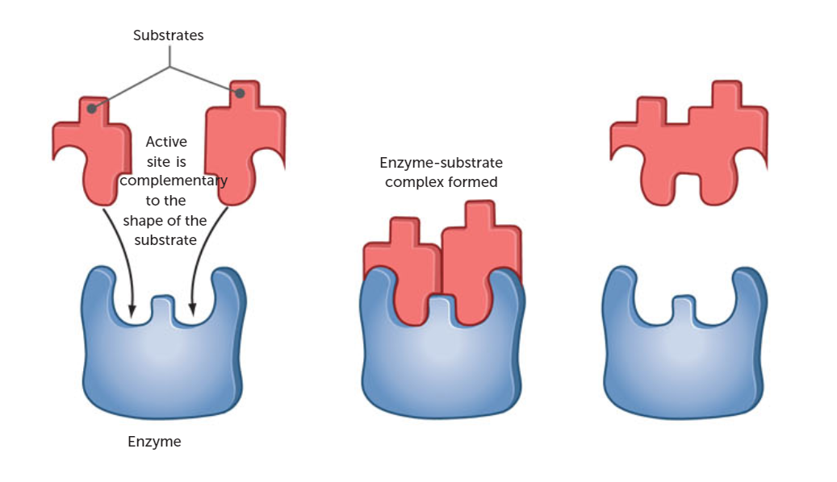
Lock and Key Model

Slide 21
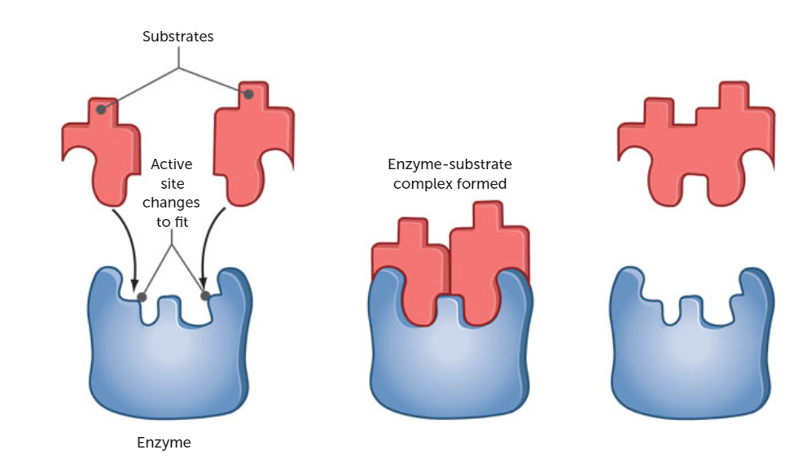
Induced Fit Model

Slide 22
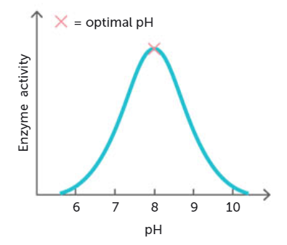
Factors affecting enzyme activity
pH
Enzymes are very sensitive to the pH of the medium in which a reaction is taking place
Each enzyme has an optimum pH at which it will work most effectively.

Slide 23
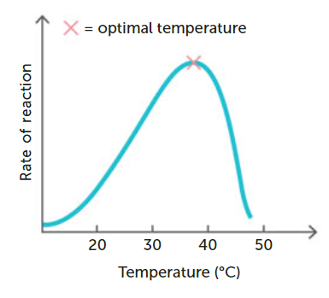
Factors affecting enzyme activity
Temperature
The rate of most chemical reactions increases as temperature increases.
This only occurs in a limited temperature range
If the temperature increases too much, the enzyme will denature (lose its shape)
If the temperature decreases too much, the enzyme will become inactive.

Slide 24
Factors affecting enzyme activity
Presence of inhibitors
Are substances that slow or even stop the enzyme’s activity
Inhibitors may be used by cells to control reactions so that products are produced in specific amounts.

Slide 25
Factors affecting enzyme activity
Co-enzymes and co-factors
Co-factors are ions or non-protein molecules that are required to catalyse a reaction
Co-factors change the shape of the active site so that the enzymes can combine with the substrate
Co-enzymes are non-protein organic molecules such as vitamins. They do the same job as co-factors

Slide 26
Factors affecting enzyme activity
Concentration of reactants and products
The higher the concentration of the enzyme, the faster the rate of a chemical reaction.
Increasing substrate concentration also increases the rate of a chemical reaction
The products of a chemical reaction must be continually remoeved otherwise the rate of reaction will slow.

Slide 27
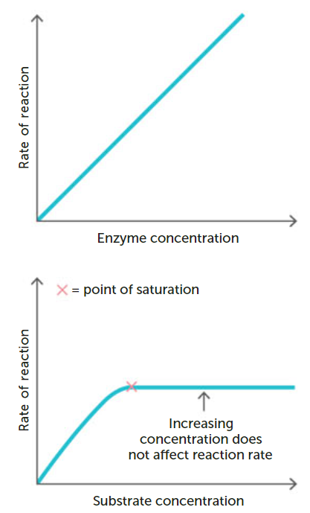

Slide 28
Recall Knowledge
List the factors that affect the activity of enzymes
Use a diagram to demonstrate the lock and key model of enzyme activity

Slide 29
Apply Knowledge
Explain why an increased temperature can:
Increase the rate of reaction
Decrease the rate of reaction

Slide 30
Homework
Describe the structure of
Carbohydrates
Lipids
Proteins
Nucleic Acids

Slide 31
Reading
Pages 63 - 69 (top half): Metabolism
Enzymes and Metabolism

